Slide 1
Standard Deviation
What is standard deviation, and how does it relate to Measures of spread?

Slide 2
Standard Deviation
Standard Deviation is the Deviation from the mean, usual broken into three sections.
The mean is represented by the symbol “ x̅ ”. The mean is the average of all scores.
To find the mean, we add all scores together, and divide the result by the number of scores.
To find standard deviation;
we subtract the mean from the result
Square the result
Add all the squared results together, and divide by the number of scores (mean of new scores)
Square root that result and you have the Standard Deviation

Slide 3


Standard Deviation - Example
A set of test scores from 6 students are listed below:
59%, 62%, 68%, 71%, 74%, and 90%.
Find the mean;
$\frac{59+62+68+71+74+90}{6}$
$\frac{424}{6}$ = 70.67%
Therefore x̅ = 70.67
Subtract mean from results and square results
(59 – 70.67)² + (62 - 70.67)² + (68 – 70.67)² + (71-70.67)² + (74-70.67)² + (90-70.67)² =
Find mean of these results:
= 136.11 + 75.17 + 7.13 + 0.11 + 11.09 + 373.65 = 603.26 / 6 = 100.54
Square root answer:
$$\sqrt{100.54}=10.03$$
- This is the standard deviation from the mean.

Slide 4
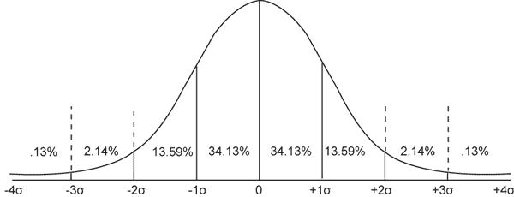
Standard Deviation - Application.
As we spoke previously about the Standard deviation and how to find it, now we can see the application of the Standard deviation.
The standard deviation tells us that we should expect about 68% of all scores between 1 standard deviation from the mean. We should also find 92.44% of all scores between 2 standard deviations.
Looking at the last example- out mean was 70.67%, and out standard deviation was 10.03%,
So 68% of our scores would be between 60.64% and 80.7%
This is 4/6 scores- 66% of all our scores are +/- 1 standard deviation from the mean.

Slide 5

Practise
The price of 6 cars is listed below ($1000’s)
5,6,7,8,10,11
Find the Mean and Standard deviation of the scores – Use the single digits, not the full number – 4 = 4000, but use 4.

Slide 6


Practise answers
The price of 6 cars is listed below ($1000’s)
5,6,7,8,10,11
MEAN:
5+6+7+8+10+11
= 47 / 6
= 7.8
Standard deviation:
(5-7.8)² + (6-7.8)² + (7-7.8)² + (8-7.8)² + (10-7.8)²
= 16.6 / 6 = 2.77
$$\sqrt{2.77}$$
$$=1.66$$
So 68% of all $ amounts should be between 6.14k and 9.46k (+/- 1 SD)
and 87% of all scores should be between 4.48k and 11.2k

Slide 7
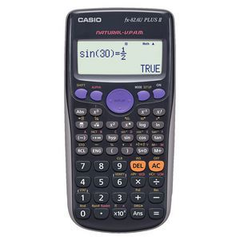
Luckily…
We have calculators to do this work for us.
Statisticians use calculations and digital program to find the standard deviation of a set of results for them.
You will need to know how to use a calculator to find the Standard deviation on your calculator.
The preferred calculator to own is the CASIO FX-82. If you can use one of these it would be the best.
If you need your teacher to email your parents about getting you one, please let them know.

